Slide 1
The Australian Army Reserve
Colonel David Lipschitz
HQ 2nd Division

Slide 2
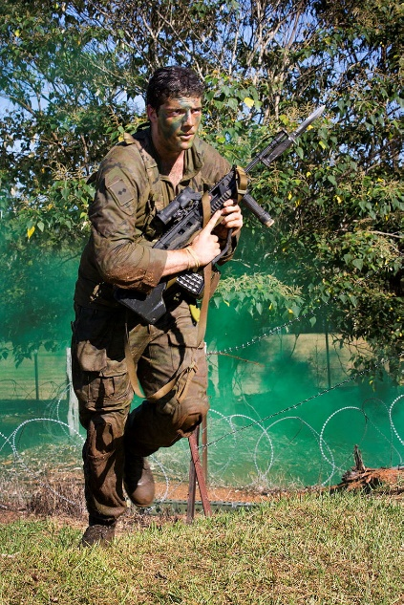
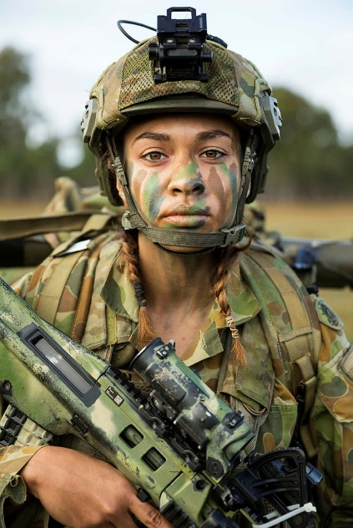
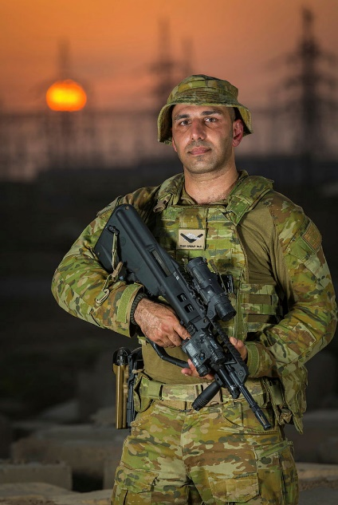
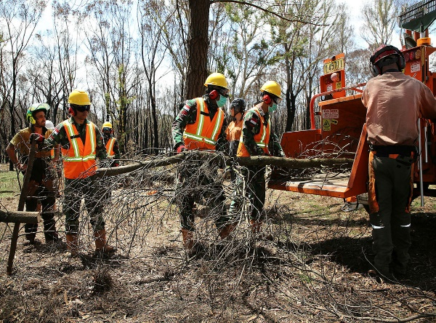
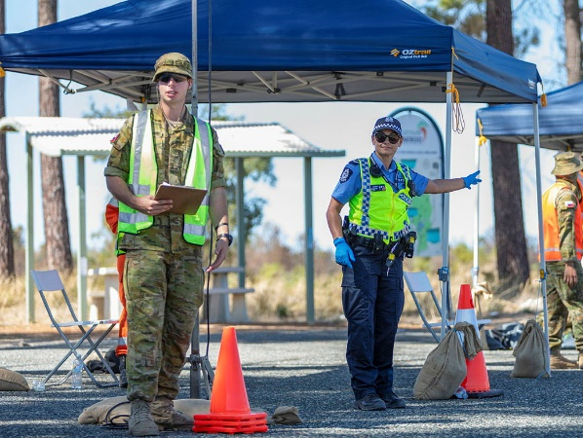
Scope of Discussion
History of the Australian Army Reserves
History of the 2nd Division
Roles and Tasks of the 2nd Division
TRAINING
EXERCISE
OPERATIONS
Training in the 2nd Division
Structure of the 2nd Division
Total Workforce System
OP BUSHFIRE ASSIST
OP COVID ASSIST
Notes:
Requested Topics for Discussion:
ARes role, tasks/functions, structure, size, and deployability
Overview of pay & conditions, legislative basis & call out powers/procedures etc.
Insights into recent experiences on O/S deployments, support to HADR/domestic responses and specialist augmentation (mil medicine, mil legal, other). What has worked, where there have been issues and any changes we are looking to make going forward under the Army Objective Force etc.
TWS - integrated ARes across the total land force (i.e. SF, Land Combat and Service Support areas).

Slide 3
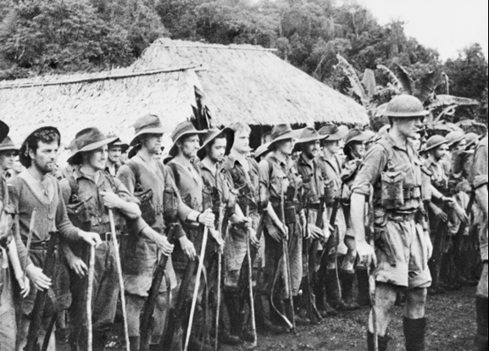
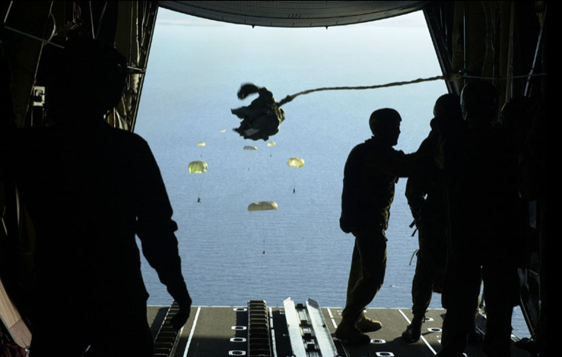
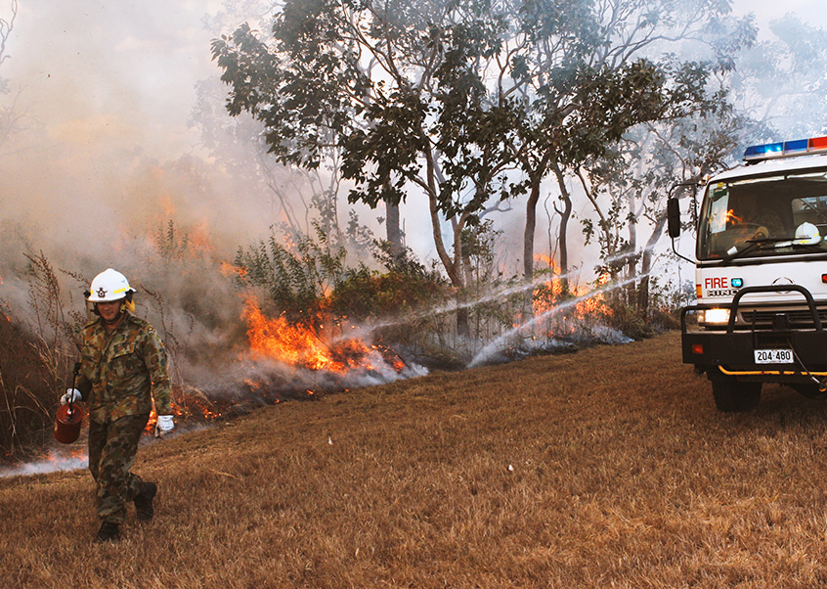
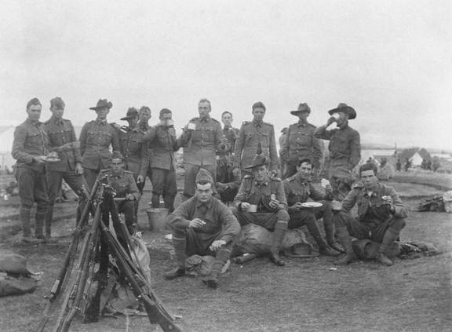
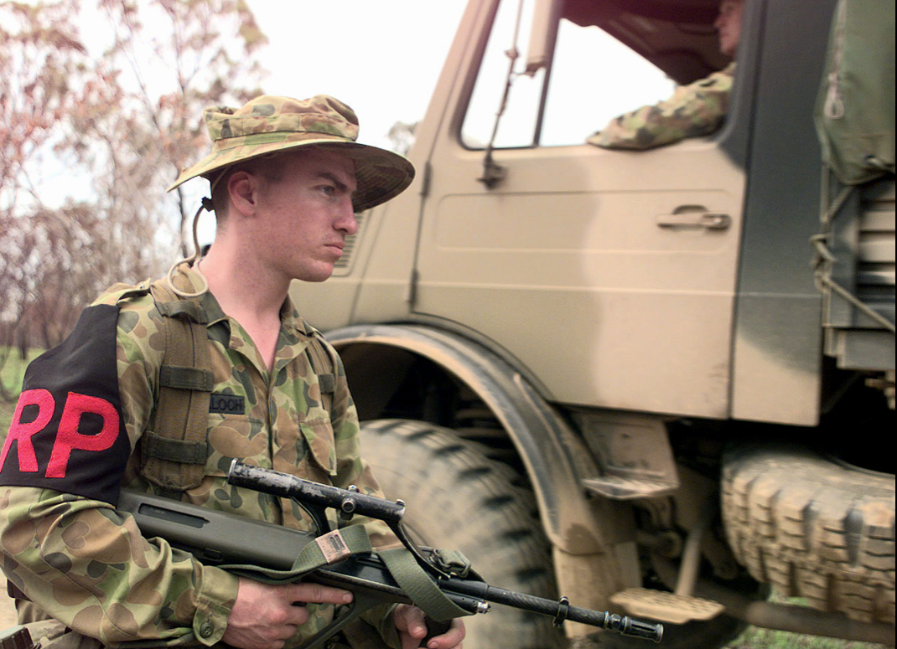
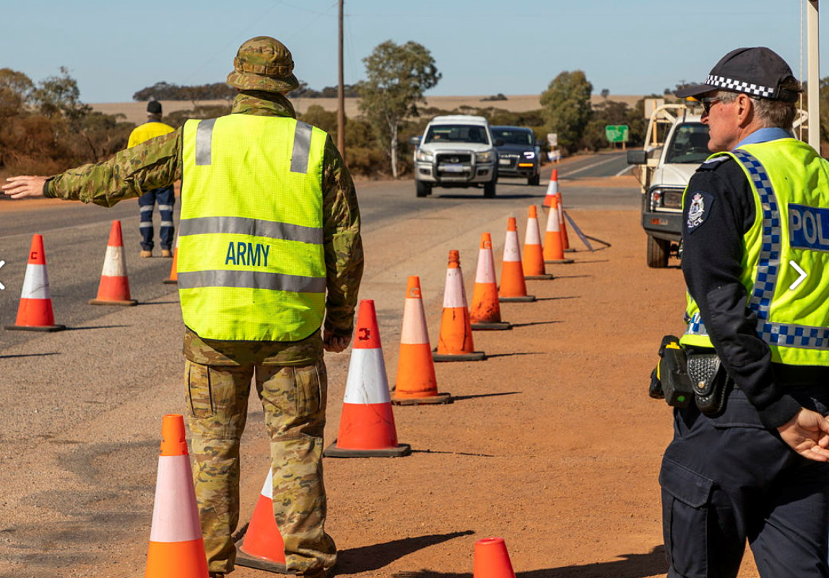
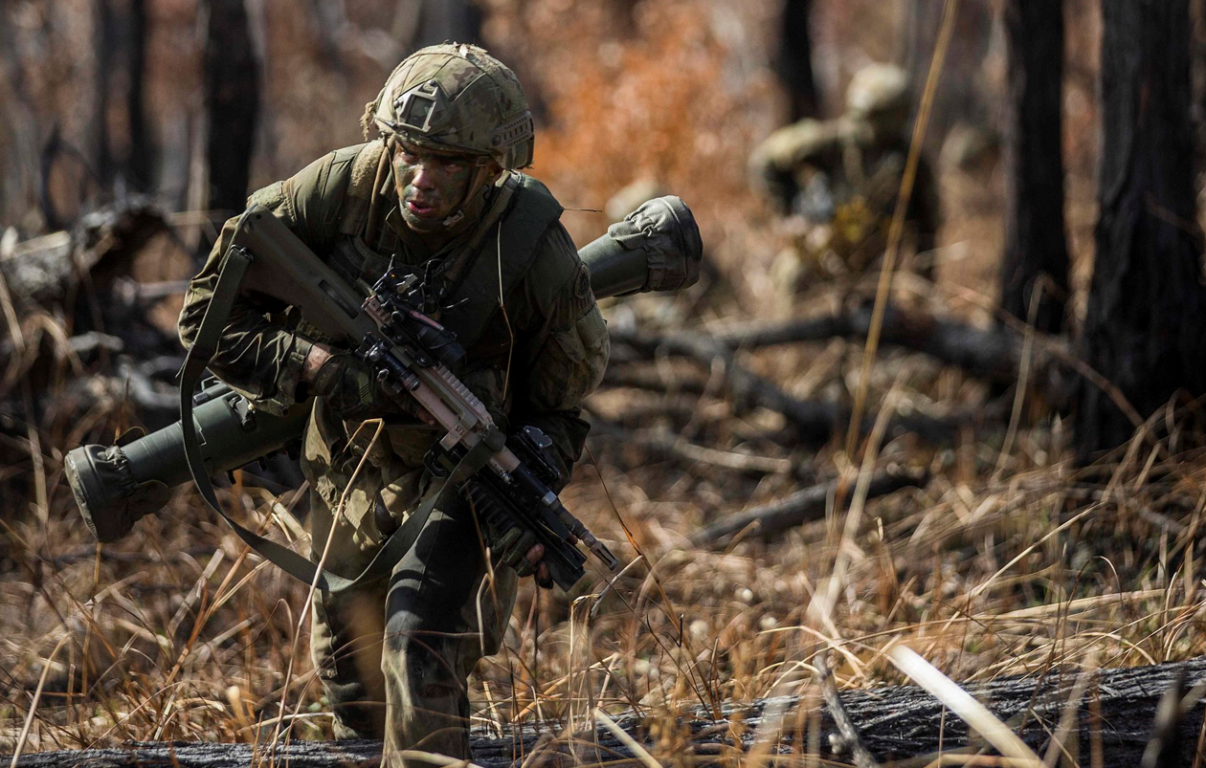
History of 2nd Division
1913
Citizen Forces and members of the Militia helped guard coastal ports and harbour defences in World War 1
1990’s
Ready Reserves Scheme and reservists conduct twelve months full-time service.
2010
Reserves continue to form specialist capability to the ADF and sustain preparedness and support to operations.
Jan 2015
2nd Division Brigades paired with regular Brigades and tasked to provide Battle Groups in Readying Cycle.
26 July 1915
2nd Division Formed
2020
The 2nd Division provides a nucleus force in times of national emergency
1939
During the outbreak of World War II, a division was raised for overseas service from volunteers
May 1948
2nd Division re-raised
2000’s
2nd Division supports major training exercises and provides a Reinforcing Battle Group
Specialist Capabilities
Reinforcing Battle Group
Domestic Response Contingencies

Slide 4
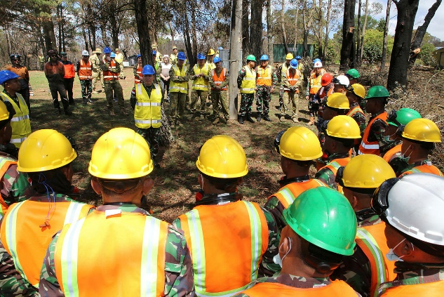
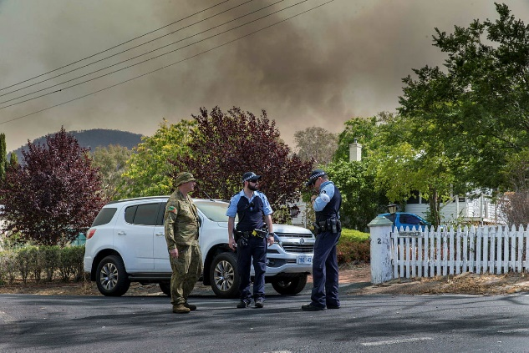
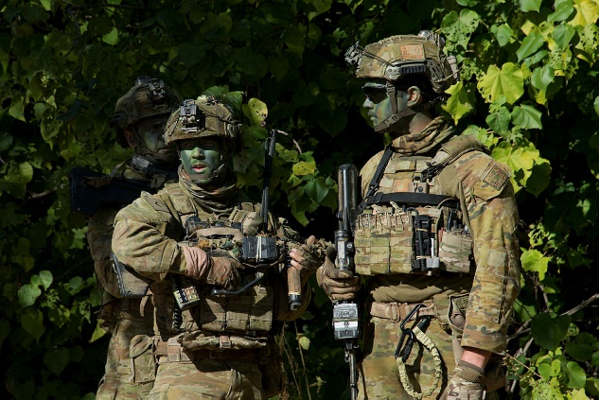
Reserve component of the workforce:
Core functions
Deliver directed capability to Army/Government
Themes
One Army
Volunteer service
Specialist and/or Niche Capability
Local community connection
Ethos
Individual Commitment and Dedication; Resilience.
How do they differ from the Regular Army component?
Service is not a reservists primary employment
Training standards and/or preparedness can be less
Army Reserve - Role
Core Function
Deliver directed capability to Army and the Australian Government
Themes
One Army with volunteer service
Specialist and niche capabilities with community connections.
Ethos
Individual commitment, dedication and resilience

Slide 5
Capability and Tasks
Replicate
Replace
Incubate
Reinforce
Resident Directed Capability
Enduring Commitments
Reinforcing Battle Group (RASO)
Civil – Military Cooperation (CIMIC)
Reserve (Individual) Training Generation
Regional Force Surveillance
Domestic Response Capability
Rifle Company Butterworth
Individual and Small Team round-out capability for all ADF Operations
Reserve augmentation specialist and niche capabilities
South West Pacific and South East Asia Engagement
Transit Security Elements (Border Protection Support)

Slide 6
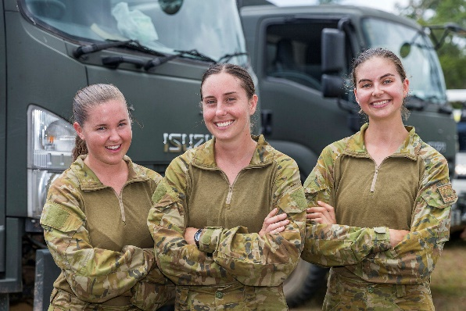
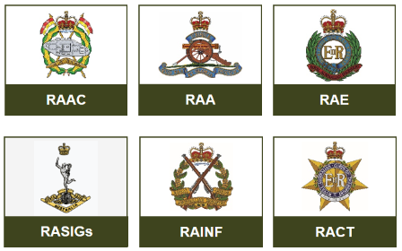
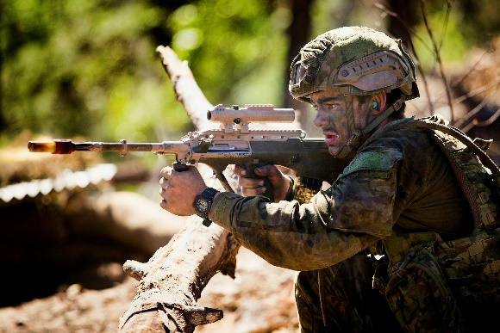
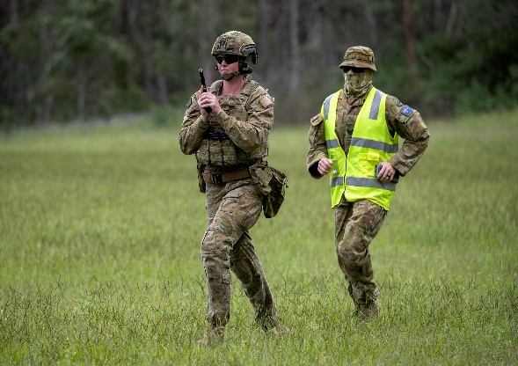
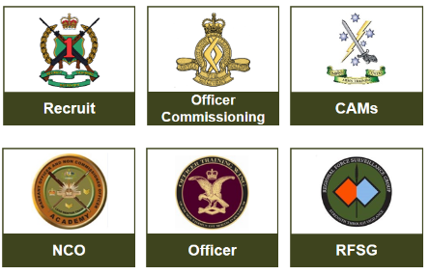
How we train
The 2nd Division force generates personnel capable of supporting the ADF training and operational requirements.
DOMESTIC RESPONSE
INDIVIDUAL AND UNIT TRAINING
CERT EX TRG
IET TRAINING
SPECIALIST TRG
The members within the Reserves builds on essential all-Corps skills and the combat mindset to support the Chief of Army’s four command themes of Preparedness, People, Profession and Potential.
AB INITIO TRAINING
The 2nd Division conducts training all over Australia to enable all Reserve members. 8 Bde is our training Bde and is responsible for scheduling and managing courses.
Notes:
Soldiers
Reserve Recruit Training Course Kapooka, near Wagga Wagga, NSW and is 35 days
Initial Employment Training. In most cases you will undertake an Infantry course, which consists of two modules conducted regionally. Module 1: 15 days continuous training (weapons and range practices). Module 2: 17 days continuous training (field craft and field exercises).
Ongoing Commitment. A minimum of 30 days per year with a 2-week continuous training or exercise phase. You can do a maximum of 70 - 100 days per year
General Service Officers
Various team leadership courses. Sydney University Regiment, Singleton, NSW in 3 x 16 days lots
All Corps Army Reserve Platoon Commander Course. RMC Duntroon, Canberra, ACT and 28 days in duration.
Special Service Officers
Specialist Service Officer training. Pre-qualified roles such as Chaplain, Doctor and Lawyer conducted in various locations across Australia. Ranges from 9 to 41 days in 3 modules.
Other forms of Training
Unit Training
Exercises
Equipment Courses such as Harris 152.

Slide 7
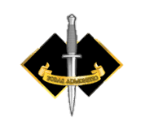
Integrated Structure
ARMY HEADQUARTERS
Combat
Army Reserves
Combat Support
Training
Combat Service Support
Headquarters
FORCES COMMAND
SPECIAL OPERATIONS COMMAND
1 DIVISION
1 BRIGADE
2 DIVISION
SPECIAL AIR SERVICE REGIMENT
2 RAR (Amphib)
4 BRIGADE
8 (TRG) BRIGADE
3 BRIGADE
2 COMMANDO REGIMENT
2/30 TRG GROUP
5 BRIGADE
REGIONAL FORCE SURVEILLANCE GROUP
7 BRIGADE
1 COMMANDO REGIMENT
COMBAT TRG CENTRE
9 BRIGADE
SPECIAL OPS ENGINEER REGIMENT
6 CBT SPT BRIGADE
11 BRIGADE
39 OPERATIONS SUPPORT BN
SPECIAL OPS LOGISTICS SQN
13 BRIGADE
1 SIGNALS REGIMENT
SPECIAL OPS TRG ED CENTRE (SOTEC)
Army Aviation Training Centre
Army Logistic Training Centre
Combined Arms Training Centre
17 Sustainment BRIGADE
ARMY’S TRAINING INSTITUTIONS
PARACHUTE TRAINING SCHOOL
Defence Force School of Signals
Defence Force School of Intelligence
Royal Military College - Army
Notes:
The 2nd Division is emerging from a period of transformation needed to prepare for the future.
In 2017/18 we restructured the Division to better focus on individual and collective training.
The 8th Brigade took command of the university regiments with a clear mandate for individual training.
The remaining brigades focused on our operational contributions and collective training to force generate these capabilities.
The Regional Force Surveillance Group comprising NORFORCE, 51 FNQR and the Pilbara Regiment continues to deliver individual and collective training and operational capability.
While majority of Reserve officers and soldiers are in the 2nd Division, there are many outside:
1 CDO REGT in SOCOMD
3 HSB and 2FSB in 17 CSS BDE
Units with Reserve elements right throughout Army and Defence
As the Senior Reserve Officer in Army, I provide advice at CASAC on not just how 2 DIV but Reserve service across Army.
My colleague Generals on CASAC have seen the value the Reserve provides and they want more of it.

Slide 8
Total Workforce System
Service Category 7
Service Category 6
REGULAR
Service Category 5
Service Category 4
SERVOP C
Service Category 3
RESERVE
Service Category 2
Service Category 1
CILVILIAN
Notes:
Transfers between the full-time and part-time components are more fluid, enabling the Army to gain more utility out of the part-time workforce and retain trained and skilled individuals after they leave full-time service.
Continued integration of fulltime and part-time personnel in units has provided further strength and depth to our capability.
Almost 30% of the part-time Army has served as full-time at some stage in the last 15 years.
85% of the Army Reserve are employed / self-employed in the civilian sector.

Slide 9
Operation BUSHFIRE ASSIST

Slide 10
Operation BUSHFIRE ASSIST
Preceded by localised ADF support to State firefighting agencies from Nov 19
Operation commenced in early Jan 20 with a ‘call-out’ of Army Reserve and force assignment
Approximately 6200 personnel (mix of reserve and regular) in three state based Joint Task Forces (JTFs) under the command of COMD 1st DIV
Approximately 2600 in support of the state of New South Wales to JTF 1110 (formed by 5 Brigade in Sydney)
Mission was to support the State led firefighting efforts in New South Wales
In support of State agencies and Local Government Areas

Slide 11
OP BUSHFIRE ASSIST 19/20 – COMMAND & CONTROL
FORCE GENERATION
STRATEGIC DIRECTION
RAN
ARMY
PMO
MINDEF
HQJOC
AOC
MAROPS
RAAF
SOCOMD
CDF
MSC
LIAISON
HEADQUARTERS
OP BUSHFIRE ASSIST 19/20
MAJGEN JAKE ELLWOOD
DIRECT SUPPORT
HQ AIR TASK UNIT
NATIONAL RECOVERY COORDINATOR
EMERGENCY MANAGEMENT AUSTRALIA
DEPT HUMAN SERVICES
LIAISON
PARLIAMENTARY
LIAISON
OPCOMD
OPCOMD
OPCOMD
OPCOMD
OPCOMD
OPCOMD
OPCON
OPCOMD
ASSOCIATED SUPPORT TO
JTF 646/1110/1111
JTF 646
VIC
BRIG DOUGLAS LAIDLAW
JTF 1111
SA / TAS
BRIG DAMIAN CANTWELL
JTF 1110
NSW
BRIG MICHAEL GARRAWAY
5 Bde (Reserve)
MULTI-NATIONAL ROTARY WING TASK GROUP
LTCOL JAMIE MARTIN
FORCE SUPPORT GROUP
BRIG CRAIG DOBSON
AMPHIBIOUS TASK GROUP
COMAUSATG
CAPT LEIF MAXFIELD
AIR MOBILE RESPONSE TEAMS
LTCOL ADAM GOWER
SPT BN – 22 ER
(AO COASTAL)
1 ARMD REGT ESF
K’ROO ISLAND
ENG TASK UNIT
(Reserve)
AEC VIC
TU CHINOOK
4 X AS CH-47F
2 X RSAF CH-47D
HMAS ADELAIDE
DIRLAUTH
JTF 1110
FORCE SPT TEAM (VIC)
TACON
TEAM 1
NOWRA
SPT BN 5/6
(AO ALPINE)
16 REGT ESF ADELAIDE HILLS
ENG TASK UNIT
(Regular)
AEC NSW
TU TAIPAN
4 X MRH 90
FORCE SPT TEAM (NSW)
HMAS CHOULES
ENGR COY (+)
PNG / 3 CER
12/40 (RTR) ESF
TASMANIA
MV SYCAMORE
DIRLAUTH
JTF 646
LOG TASK UNIT
(Reserve)
AEC ACT
TU RNZAF
3 X NH 90
FORCE SPT TEAM (SA)
TEAM 2
EAST SALE
SPT BN 7 CSSB
(TBC)
10/27 (RSAR) ESF AS REQ’D
FORCE SPT TEAM (TAS)
TU MARITIME
2 X MRH 90
2 X MH-60R
2 X EC135
CSSB
V1.1 correct as at 11 Jan 20
POC for Amendment: MA – travis.day1@defence.gov.au

Slide 12
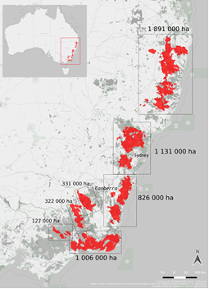
AOs and Tasks
Engineer task units deployed into the Snowy Mountains and South Coast AOs
These AOs had the most significant damage
Rural areas with the least amount of Local Government and State Government capacity
General duties task unit (Infantry with some Engineering capacity) deployed into Central AO in the area know as the Blue Mountains and Southern Highlands regions
Brigade HQ and a Logistic task unit based out of Holsworthy Barracks
Brigade Tac HQ collocated with State Emergency Services in Sydney central
Range of tasks included:
road clearance
clearance of debris and fallen trees
direct assistance to emergency services
delivery of urgent supplies
assistance to rural landholders and industry
Central AO
Snowy Mountains AO
South Coast AO

